Slide 1


PRESENTATION
ON
“GPS Toll based System simulation using Python”
Submitted by
Ms. Shravani S. Shegokar
Mr. Shriyansh R. Fasate
Under the Guidance of:
Intel Industry Mentor:
Mr. Amit Aggrawal
Mr. Sriharsha Gajavalli
Dr. R R. Karwa
Prof A. U. Chaudhari
Prof. Ram Meghe Institute of Technology and Research, Badnera,
Amravati.
(An Autonomous Institute & NAAC Accredited)
Sant Gadge Baba Amravati University, Amravati
2024-2025

Slide 2
Team :
TECHCONNECT

Slide 3
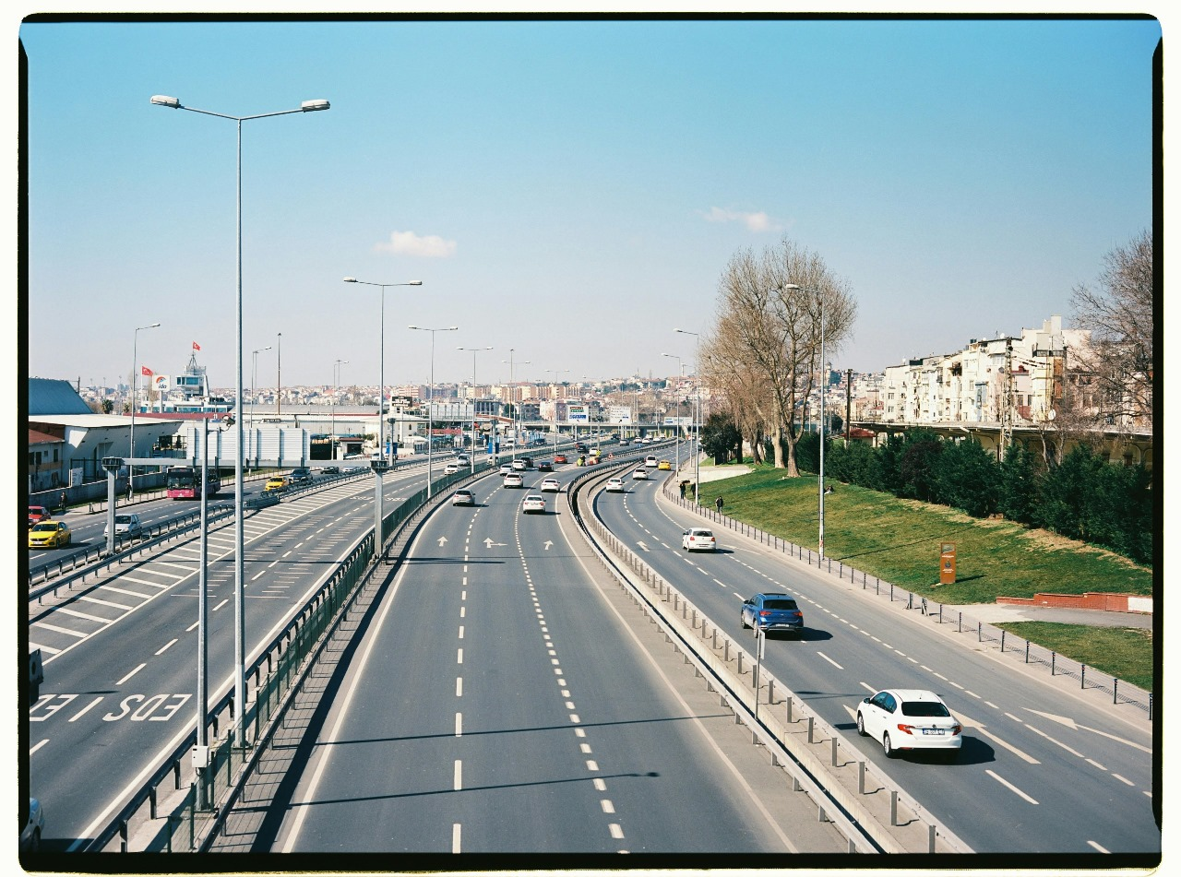
GPS Toll based System simulation using Python

Slide 4
Problem statement
India's dominant transportation sector relies heavily on toll plazas, but overcharging drivers is a major issue. our project aims to collect toll tax for precise vehicle distances with the help of GPS coordinates providing accuracy and Convenience

Slide 5
Unique Idea Brief
• Simulation determines the toll tax on based of vehicle type.
• The vehicle's trip route is defined in a data set because we are not utilizing any hardware or devices.
• The zone is defined, and rather of utilizing a zone or area on the map, we used route coordinates to increase toll count accuracy.
• Since weather affects vehicle signaling, the route's point-to-point coordinates aid in the equitable computation of tolls.
• To address the possibility of long-term unpaid toll bills, we have automated payment processing.
• This simulation may be used in the real world as it gives users a smooth experience and records their

Slide 6
Features Offered
● Automatic Toll Deduction: Based on the user's journey distance, tolls are automatically deducted from their account. ● User Data Privacy: User data is protected to ensure privacy and security.
● Multiple Payment Vendors: Supports a variety of payment methods for user convenience.
● Auto-Generated Invoices: Invoices are automatically generated for each toll transaction, allowing for easy record keeping and analysis.
● Auto-Fine: A simulation automatically Generate fine for a vehicle if it cross speed limit.
● Auto-Speed Generation: Simulation automatically Generate Avg. speeds for vehicles (likely for analysis purposes).
● Simulated Environment: Built using Flask to create a realistic simulation of the automatic toll system.

Slide 7
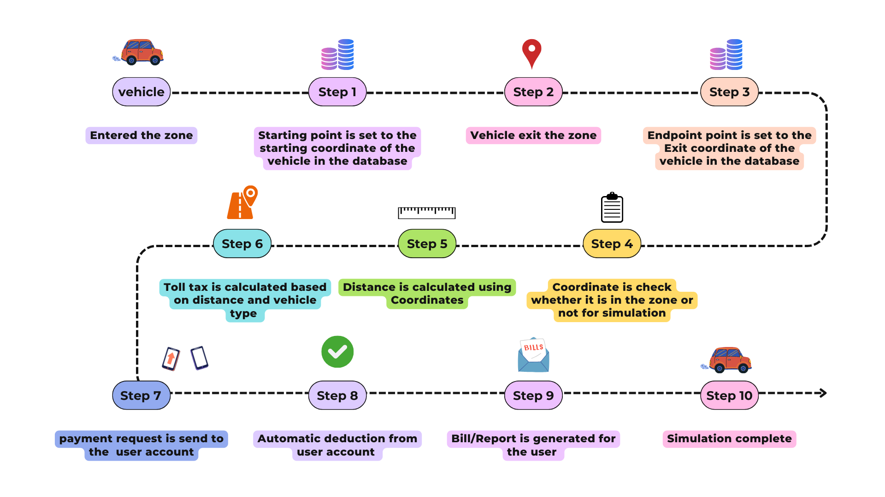
Process Flow

Slide 8
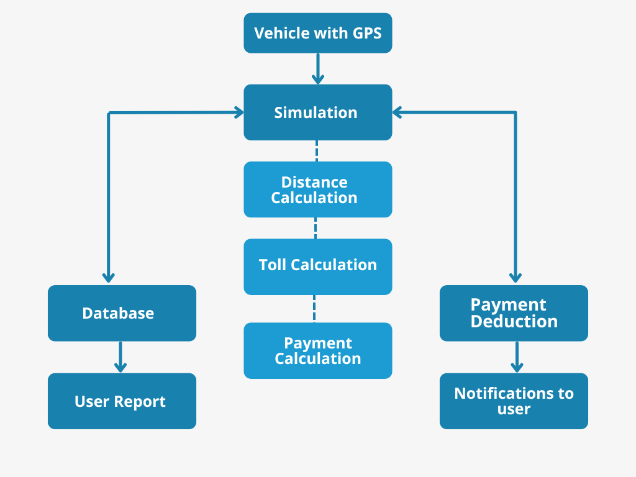
Architecture Diagram

Slide 9
Technologies Used
Python: python version 3.11.8 . Python boasts a rich ecosystem of libraries that can enhance our simulation. It also provide Readability , Flexibility, Versatility etc.
Libraries: geopandas, folium, matplotlib, geopy ,flask
Mapping: Libraries like matplotlib or folium.
Framework : Flask framework.
Database : sqlite3
Integrated Development Environment (IDE): Visual Studio Code.
Hardware required : CPU for simulation (intel i5 / intel i3)

Slide 10
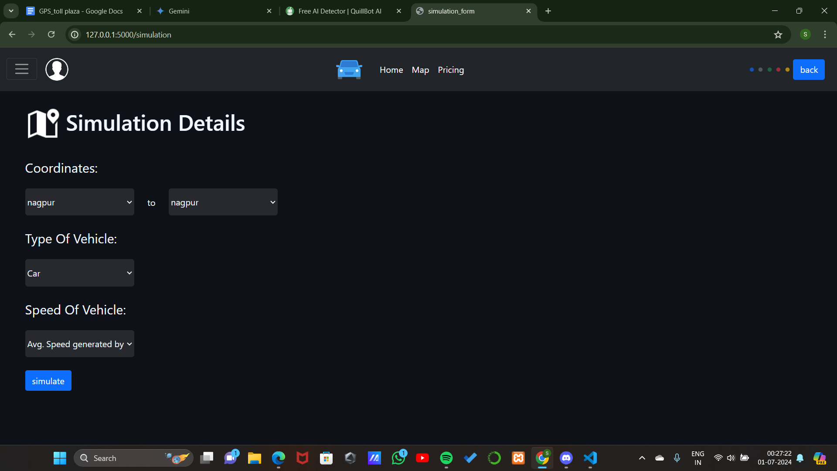
Result and Implementation
The Python simulation demonstrated the feasibility of a GPS-based toll system, improving traffic flow, reducing travel times, and eliminating physical toll booths. The system ensures fair charges based on distance traveled and vehicle type, and can be adapted to different road networks and structures.

Slide 11
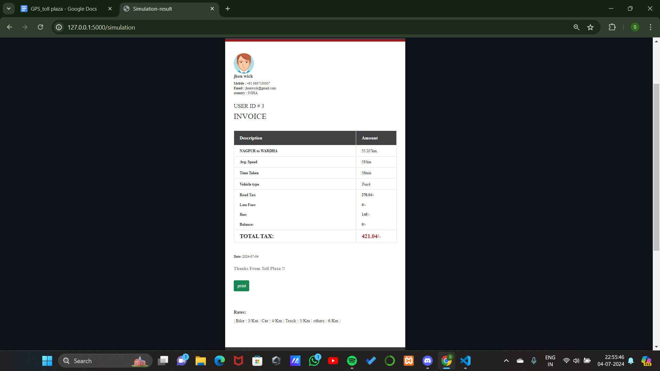
The existing system's reliance upon a .CSV file for location data is one of its limitations. Although this strategy works, it has limitations with regard to scalability and efficiency. Real-time GPS tracking would provide several benefits, including streamlined data collecting, increased accuracy, and simpler system expansion for future use.

Slide 12
Team Member & Contribution
Shravani S. Shegokar
Developed UI for GPS toll-based system simulation with a focus on optimal user experience. Gave precedence to interactivity and ease of use so that customers could easily envision the simulation process without any complications. Moreover, it introduced data visualization capabilities in the feature, depicting displayed costs, locations of tolls and paths simulated.
Shriyansh R. Fasate
The core logic was developed using the Flask framework. Establish the communication between the frontend and backend for a seamless user experience by designing communication protocols. Extract GPS coordinates accurately from CSV data retrieved: develop the toll system simulation program that determines distance between selected toll locations and vehicle-specific tax through the GPS information received.

Slide 13
Conclusion
The GPS-toll based system simulation built into Python offers a more successful and efficient toll collection method. The benefits of using GPS locations for dynamic toll computations are illustrated by the simulation. As a result of the system's removal of actual toll booths, traffic congestion may be decreased. In addition, the system has an admin interface, a speed restriction, and a graph that shows the whole path the vehicle has taken. The system is portable and allows for simple monitoring from any location thanks to the admin portal. The imposition of fines for speeding violations aids in the control of traffic jams, and the vehicle's route graph preserves system transparency by showing the precise path taken, its length, and the amount of tax deducted.

